Slide 1
A Scottish perspective on gender inclusive languages education
Suzanne Ritchie and Lynne Jones
Professional Development Officers
SCILT, Scotland’s National Centre for Languages

Slide 2
In this webinar you will hear from Lynne and Suzanne, two teachers working in Scotland, about our journey to widen the professional dialogue around inclusive languages education.
More specifically, we will explore the changing landscape around gender inclusive language. We will compare it to other societal changes in language use, and discuss the factors for consideration when integrating gender inclusive language into teaching practice.
You will also have the opportunity to share your own experiences from the Norwegian context.

Slide 3
Why did you choose to attend this webinar? What do you hope to take away from this session?
Go to www.menti.com
Code: 67 54 11 8

Slide 4
A Scottish perspective on gender inclusive languages education
A definition
Towards a rationale for gender inclusive languages education
Incorporating gender inclusive language into our teaching
Norwegian perspectives
Q&A

Slide 6
Towards a rationale for gender inclusive languages education

Slide 7
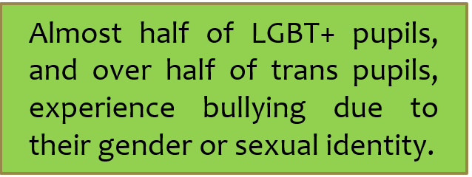

Slide 8
Incorporating gender inclusive language into our teaching practice

Slide 9
Describing a picture
This Photo by Unknown Author is licensed under CC BY-SA-NC

Slide 10
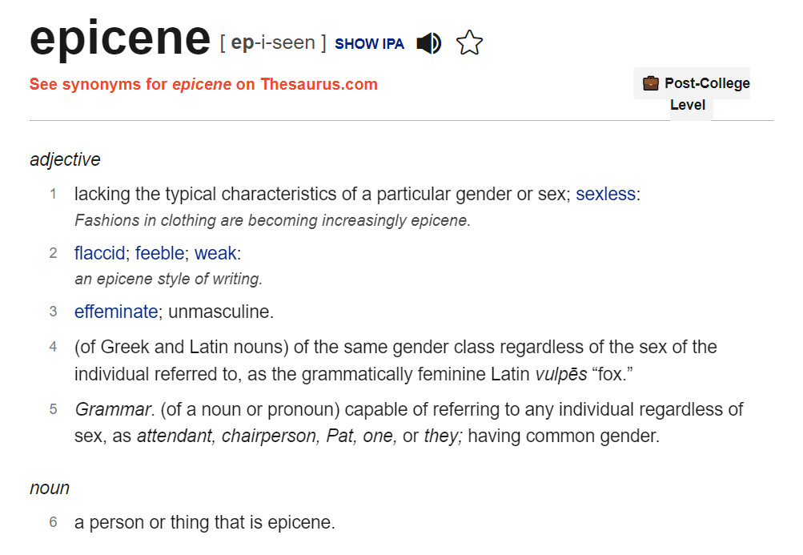
Mind your language! Modelling language.

Slide 11
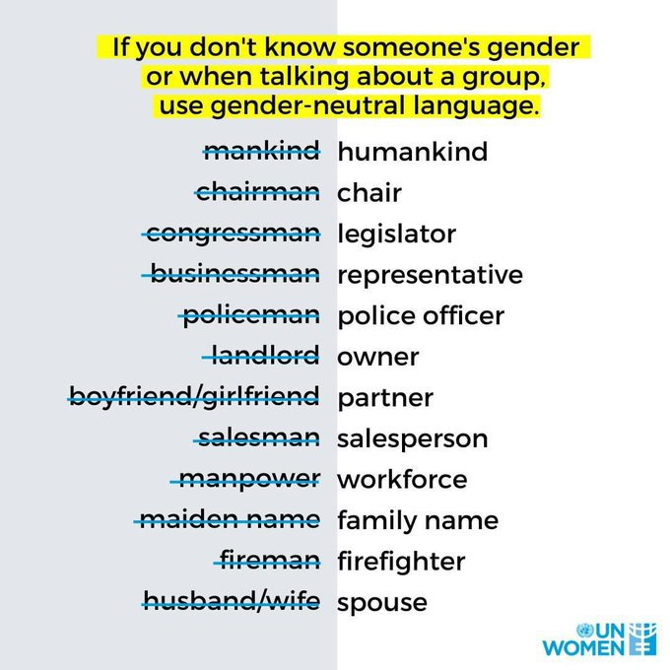
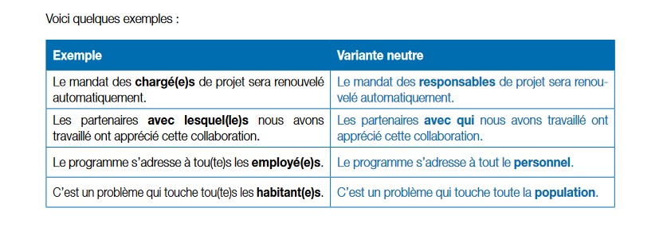
Mind your
language! Modelling
Language.

Slide 12
forward slash / Lehrer/-innen
Binnen-I LehrerInnen
bracket () ein(e) Lehrer(in)
asterisk * Lehrer*innen
underscore _ Lehrer_innen
naming both zwei Lehrerinnen und ein Lehrer
le point . Cher.e.s ami.e.s
neologism Mi hije, Mi hij@, Mi hijx
schwa carə studentə

Slide 14
Norwegian perspectives on gender inclusive languages education

Slide 15
What does the term ‘gender inclusive languages education’ mean to you now? What implications are there for your teaching practice?
Go to www.menti.com
Code 1484 4886

Slide 17
lynne.jones@strath.ac.uk
suzanne.ritchie@strath.ac.uk
@Lynne_SCILT
@SuzanneSCILT
謝謝

