Slide 1
Presentation of Østfold University College

Slide 2
Vision: Working with society - for the future

Slide 3
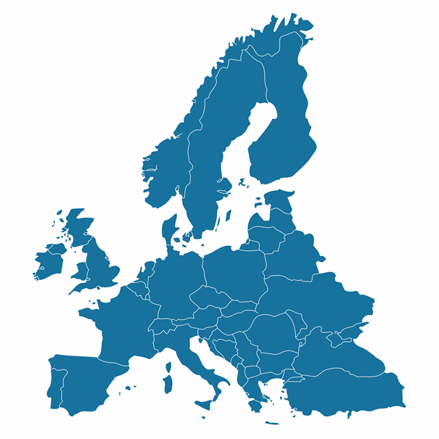
About Østfold University College
Established in 1994
State-owned university college
Total state-owned institutions of higher education in Norway: 10 universities 6 university colleges 5 scientific colleges
Østfold University College

Slide 4
Key figures:
7700 students
570 staff members
6 faculties
23 bachelor programmes
14 master programmes
1 PhD programme in development
2 campuses
Østfold University College

Slide 5
Campus Halden

Slide 6
Campus Fredrikstad

Slide 7
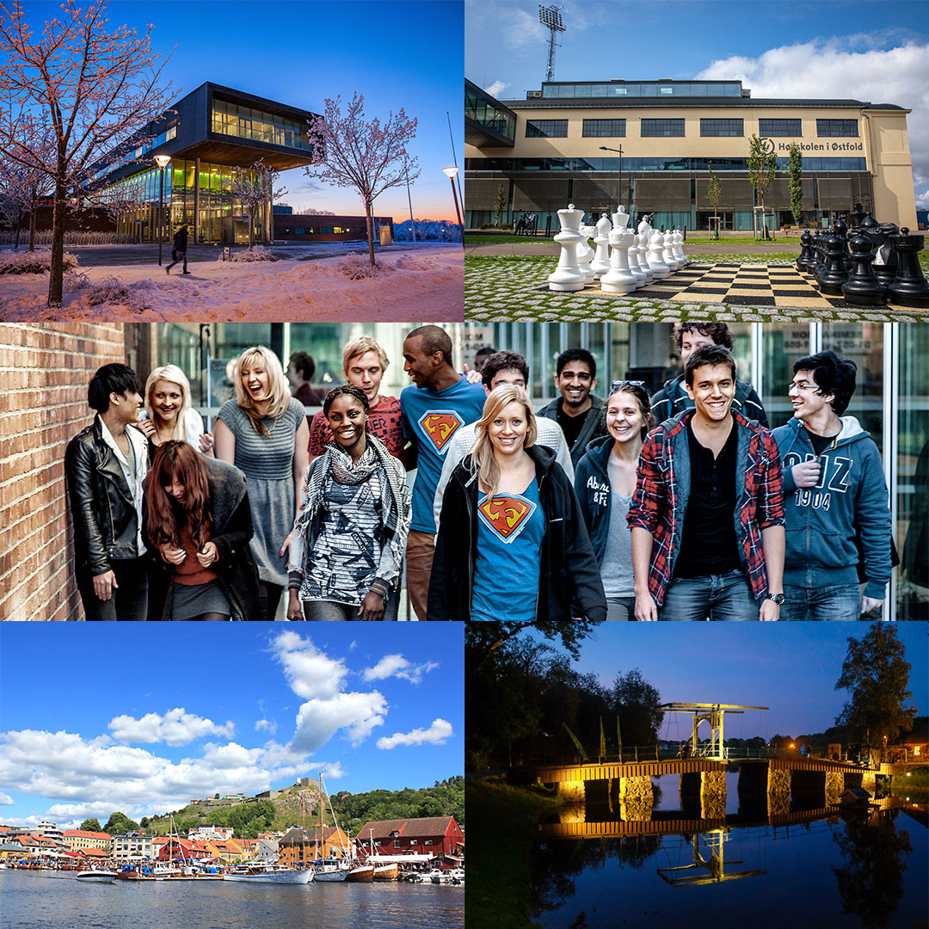
Faculties
Halden
Faculty of Business, Languages and Social Sciences
Faculty of Computer Sciences
Faculty of Education
The Norwegian National Centre for Foreign Languages in Education
Fredrikstad
Faculty of Engineering
Faculty of Health and Welfare Sciences
Norwegian Theatre Academy

Slide 8
The Faculty of Business, Languages and Social Sciences
Master:
Organisation and Leadership
Foreign Languages in the Classroom (German, French and English)
Bachelor:
Business Administration
Accounting and Auditing
International Communication
Society, Language and Culture
One-Year programmes and Extension courses :
English, French, German, Spanish and Political Science
English, French, German and Spanish for Teachers

Slide 9
The Faculty of Computer Sciences
Master:
Applied Computer Science
Bachelor:
Computer Sciences
Digital Media and Design
Computer Engineering
Information Systems
One-Year programme:
Computer Sciences

Slide 10
The Faculty of Education
Master:
Primary and Lower Secondary Teacher Education for years 1-7 and 5-10
Early Childhood Studies (0-3 years)
Norwegian Language Education
Special Education
Bachelor in Kindergarten Teacher Education
Practical Pedagogical Education (teacher training)
One-Year programmes

Slide 11
The Faculty of Engineering
Master:
Green Energy Technology
Bachelor:
Civil Engineering
Chemical Engineering
Mechanical Engineering
Electrical Engineering
Industrial Design
Innovation and Project Management
Biomedical Laboratory Science
One-Year Foundation Course

Slide 12
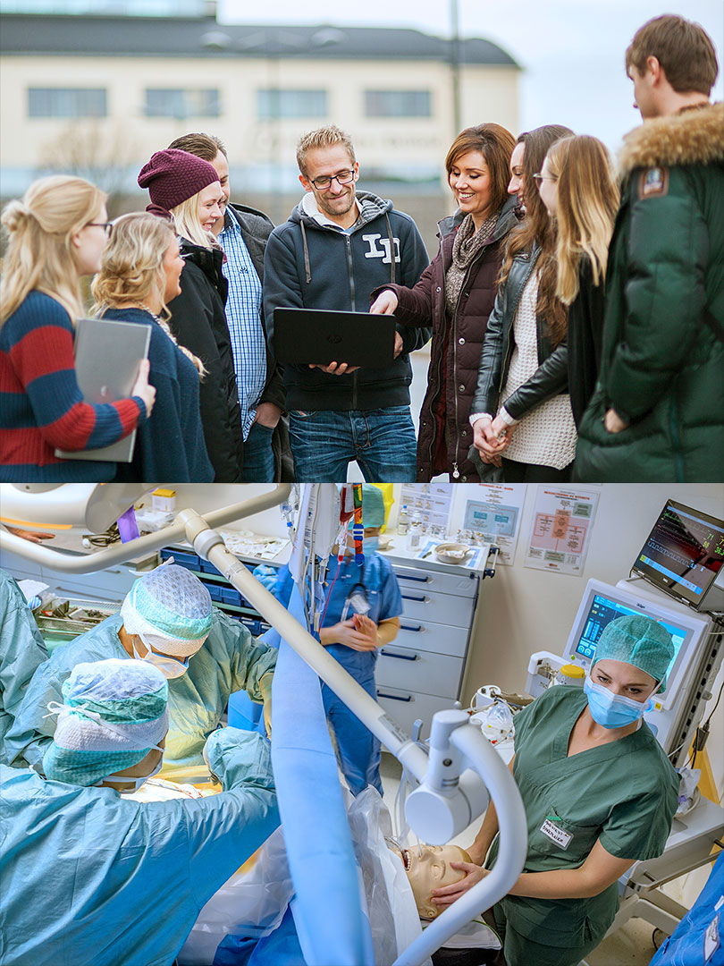
Faculty of Health and Welfare Sciences
Master:
Integrated Health and Welfare Services
Psychosocial Work – Professional Health and Welfare Practices
Advanced Nursing in Chronic Illness
Bachelor:
Nursing
Social Work
Child Welfare Work
Social Educator Training
Work and Welfare Studies
Advanced Courses for Health Professionals

Slide 13
Norwegian Theatre Academy
Master:
Scenography
Performance
Bachelor:
Acting
Scenography

Slide 14
Reasearch and Development
Multi- and interdisciplinary research activity
Three research pillars:
Research on working life, professions and services
Technology, energy and society
School, knowledge and teacher education
Administrative support is given by the R&D unit which is led by the research director
A PhD programme in development Working title: The Digital Society

Slide 15
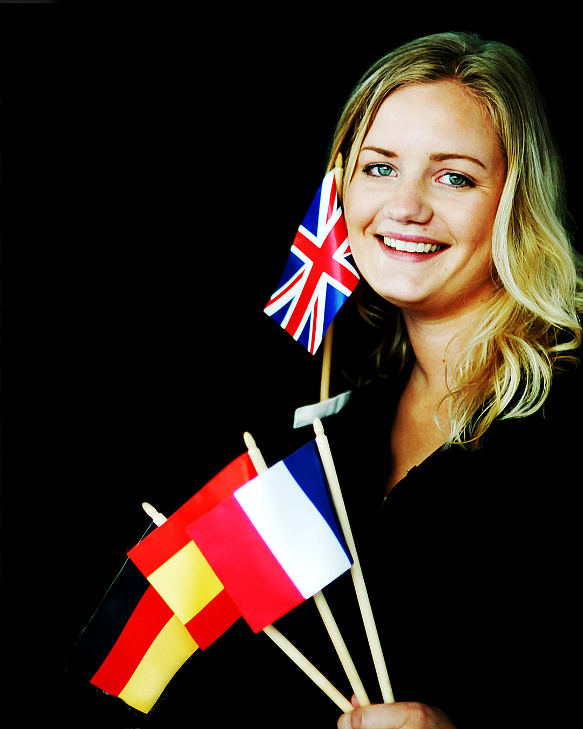
International Relations
Østfold University College collaborates with over 100 universities worldwide and participates in exchange programmes such as Erasmus + and Nordplus
Norway has adopted the Bologna degree structure, ECTS credits and grading scale
All students have the opportunity to exchange during their studies
We welcome a significant number of international students and guest lectures each year

Slide 16
Courses for exchange students
Most of our study programmes are taught in Norwegian. However, we also offer an increasing number of courses taught in English, German, French and Spanish
Courses for exchange students

Slide 17
Academic year
Full academic year: mid-August to mid-June
Autumn semester: mid-August to mid-December
Spring semester: primo January to mid-June

Slide 18
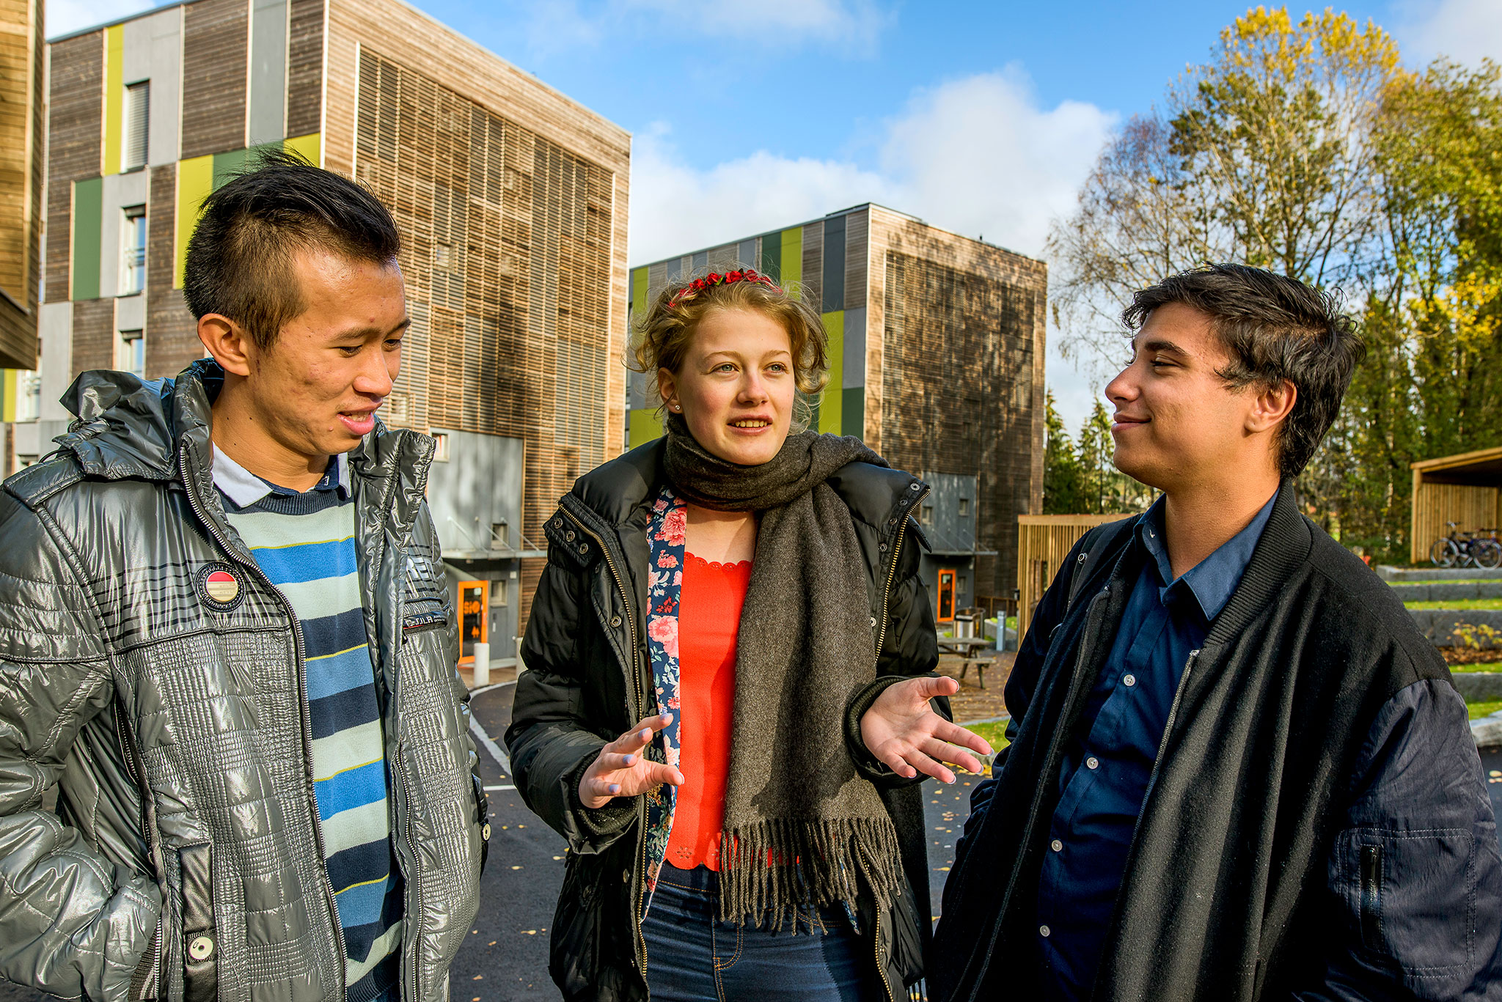
Accommodation
International students are guaranteed university accommodation
The rent ranges from 411 EUR to 989 EUR per month
Residence halls are all within short walking and cycling distance from the campuses
Rooms varies in terms of appearance and size, but are all fully furnished
Internet access in all rooms

Slide 19
Why students chose Østfold University College
Proffessionally oriented study programmes
Modern teaching and research facilities
A close-knit university college with small class sizes
Variety of organisations and societies for students, like the Buddy Scheme and Introduction Week
Proximity to nature and great outdoor activities

Slide 21
www.hiof.no/english

